Slide 1

REGISTRATION PORTAL FOR JAVA COURSE
Chavali Surya Teja
BL.EN.U4AIE19014
Sem - II, C - Section (CSE-AI)
19AIE111- DATA STRUCTURES AND ALGORITHMS - 1

Slide 2
ABSTRACT
This project is an Application Portal for the registration of a JAVA course. This project has been done using the Linked Lists Data structure. Java’s built-in class for Linked Lists has been used here. It mainly consists of 2 classes –
Candidate_Registration_Number,
Candidate_Registration_Number_GUI
The GUI consists of two text fields, namely:
Name
Mobile Number
And several other options(buttons), such as Add Candidate, Delete Candidate, Edit the details of a Candidate, then saving them, Display the list of candidates, and finally the exit option.

Slide 3
Classes and Modules
This project mainly consists of two classes :
1.) Candidate_Registration_Number :
This class stores the information regarding the person’s name and their respective mobile number and generates their respective registration numbers. These are the main attributes and are strings.
2.) Candidate_Registration_Number_GUI:
This is the main class related to the project, where the GUI is created, we call the 1st class, and the linked list is going to store the objects of the first class.

Slide 4
Classes and Modules
Modules:
A total of five modules have been imported in the main class.
These are:
javax.swing
java.awt
java.awt.event.WindowAdapter
java.awt.event.WindowEvent
java.util.LinkedList

Slide 5
Data Structure Used
Linked List :
A linked list is a linear data structure, in which the elements are not stored at contiguous memory locations. The elements in a linked list are linked using pointers.
Java’s in-built Linked Lists module has been used in this project.
Candidate’s objects are in a LinkedList and allows the user to Add Candidates, Edit credentials and save them, Delete Candidates, Display All Candidates.
For each and every button we implement an Action Listener and then when we click that button, the program is going to run that respective method.
And finally, when we create that method , we call the before initialized linked list and pass the Candidates name and mobile number as objects.

Slide 6
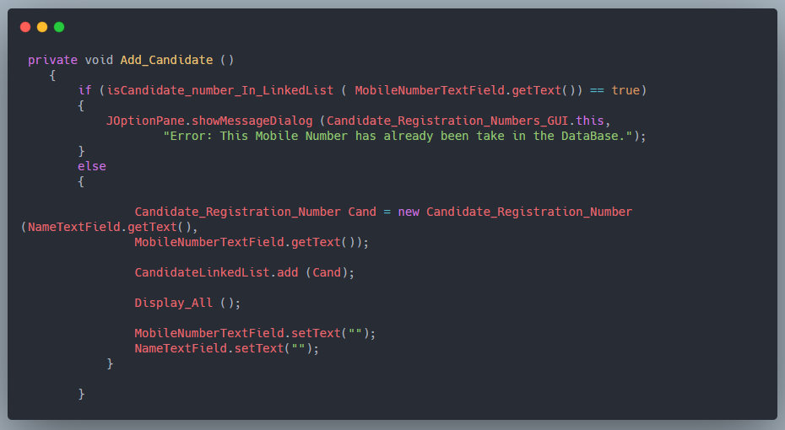
Sample Code

Slide 7
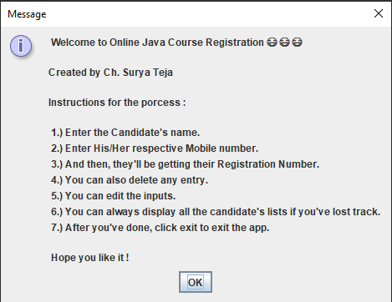
Output / Snapshot

Slide 8
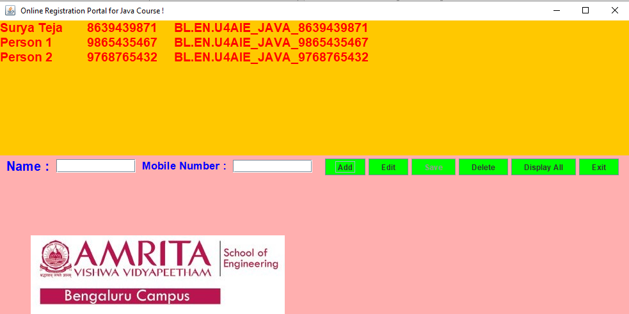
Output / Snapshot

Slide 9
THANK YOU
☺☺☺☺☺☺☺☺☺☺☺☺☺☺☺☺☺

